Slide 1
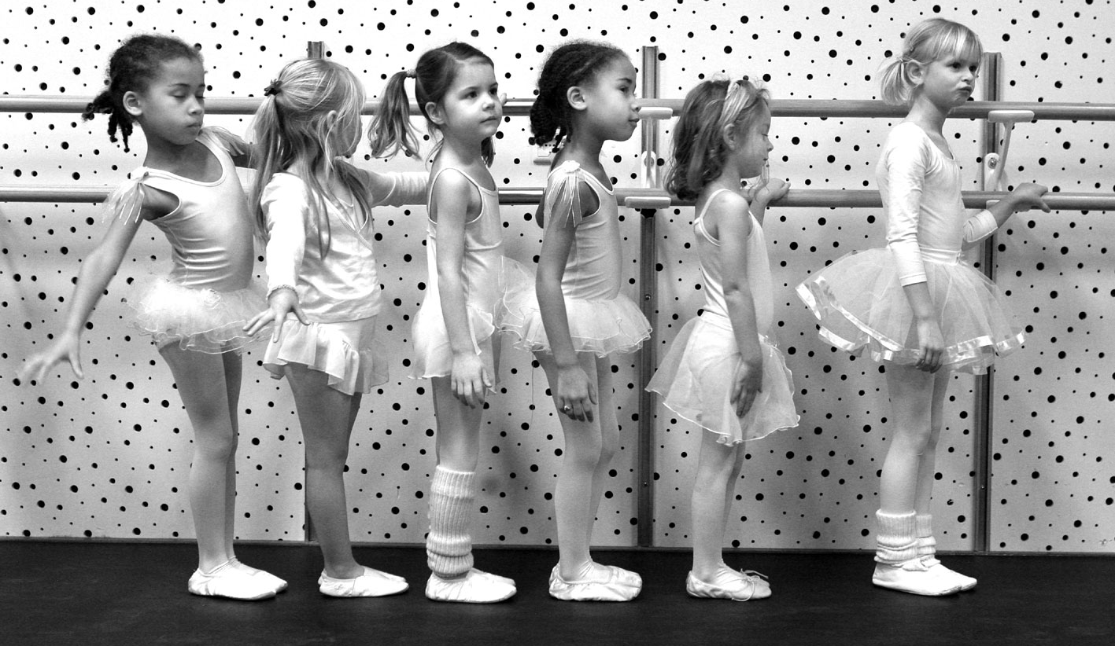

Social & Personality Development in Childhood
[Professor Name]
[Class Section Number]
Notes:
Social and Personality Development in Childhood can be taught in one class period. If you are not teaching gender on its own it can be incorporated at the end of this section as extra lecture and discussion material.
Warm Up Discussion: Ask students to think of specific examples from their own childhood that they think helped shaped their personality. Ask them to keep those examples in mind during the class discussion, as you cycle through the various influential factors

Slide 2
Overview
Introduction
Family Relationships
Early Attachment
Parenting Styles
Peer Relationships
Social Understanding
Personality
Social and Emotional Competence
Activity
Notes:
The purpose of this slide is to provide students with an overview of the material that will be covered during the lecture.
Technical Note: These slides may contain simple click animation so that you can focus students’ attention on a particular question, a selection of text, or an image and not have them be distracted by reading ahead. You can either preview the sequence of animation by going through the slides in slideshow view, visiting the animations tab, or reviewing the slide notes. In the notes you will see a cue - (Click) – that corresponds to each animation.
You will also find hyperlinks to outside videos at various places in the slides. These hyperlinks are embedded in text and indicated by color and in the notes section.

Slide 3
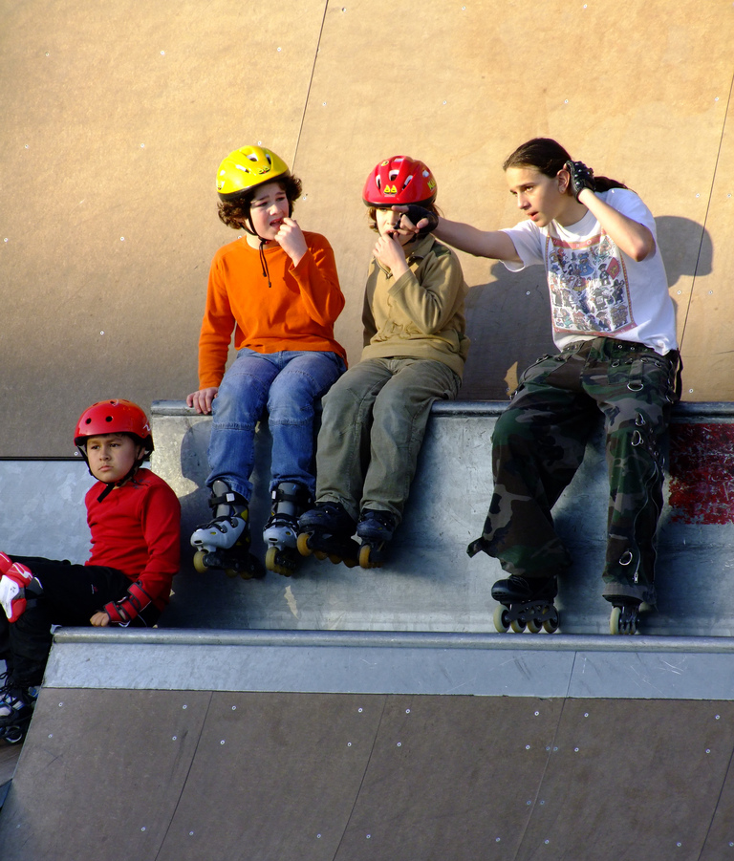
Introduction
What experiences have the biggest impact?
Who has the biggest impact?
How do influences change over time?
Notes:
This slide is meant to get students thinking critically about social and personality development.
Begin by eliciting responses from the students to each of the following questions, and asking students to provide a rationale for their answers..
(Click) What experiences have the biggest impact?
Discussion question: What experiences have the most significant impact on who someone becomes?
Examples students generate might include: travel, financial success or hardship, education, immigration, death in the family, divorce; isolated events and long-term circumstances both can have a tremendous effect on development.
(Click) Who has the biggest impact?
Discussion question: Who has the most significant impact on who someone becomes?
Examples students generate might include: parents, teachers, peers—essentially anyone who would have an influential relationship with a child or adolescent.
(Click) How do influences change over time?
Discussion question: How do changes over the long-term affect what influences a person’s identity and outlook?
Examples students generate might include: going to college, getting a job, parental death, marriage, parenthood—essentially any major life shift or relationship change that comes with aging.
Explanation: This goes right to the heart of nature/nurture interaction. As relationships and circumstances change and develop, an individual’s temperament and values adjust and adapt. Biological maturation plays a powerful role in interpreting such changes, and in developing social and emotional competencies.

Slide 4
Overview
Introduction
Family Relationships
Early Attachments
Parenting styles
Peer Relationships
Social Understanding
Personality
Social and Emotional Competence
Activity
Notes:
The purpose of this slide is to provide an overview of the material that will be covered in the lecture.

Slide 5
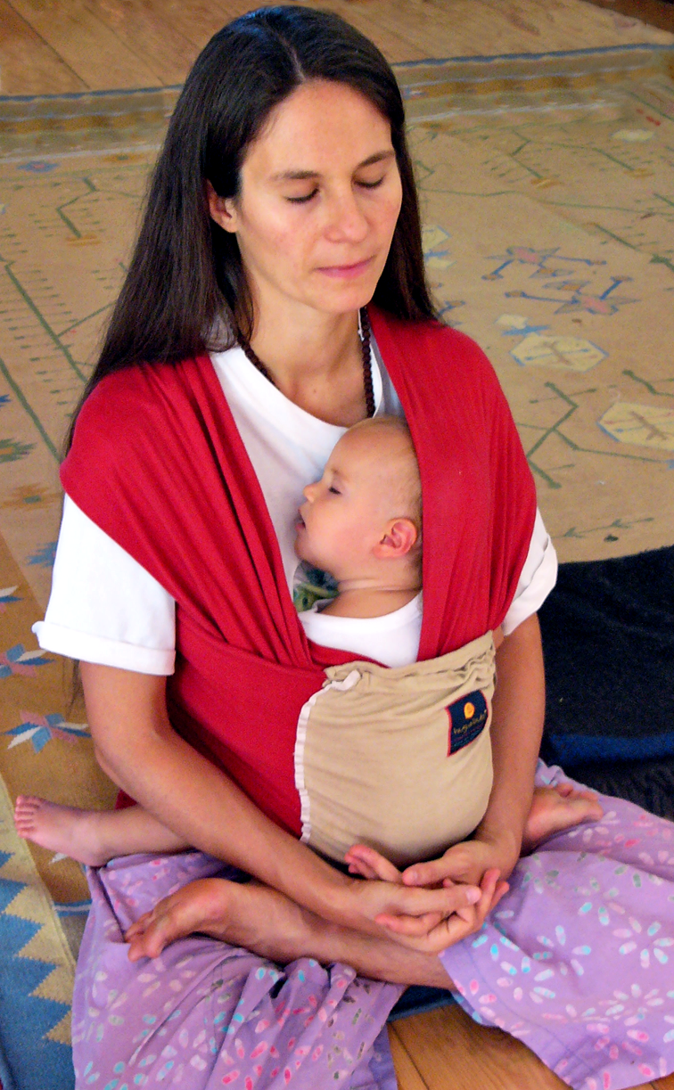
Early Attachment
Strong emotional attachment
Attachment styles
Secure
Insecure
Avoidant
Ambivalent
Disorganized
Notes:
This slide illustrates the importance of early attachment to primary caregivers (usually a child’s family).
(Click) Strong emotional attachment
Instructor’s note: Explain that early attachment is not simply a byproduct of the parents’ provision of food or warmth. Rather, attachment is an evolutionary development promoting children’s motivation to stay close to those who care for them, thus reaping the benefits those close relationships provide: learning, security, guidance, warmth, and affirmation.
Discussion question: What are some of the ways infants’ behaviors might vary depending on their relationships with their parents?
(Click) Attachment styles
Explain that there are different forms of emotional attachment, depending on the level of infants’ confidence that their caregivers will provide necessary support.
(Click) Secure
Parents are sensitive and responsive, promoting a strong sense that the infant’s needs will be met.
(Click) Insecure
Parents are insensitive and neglectful, promoting avoidant, resistant, or disorganized behavior.
(Click) Avoidant
A child may demonstrate avoidant behavior, such as ignoring a parent, as a defense against possible rejection from that parent.
(Click) Ambivalent
A child may demonstrate conflicting behavior (resistance and affection) as a response to inconsistent care and support from the parent.
(Click) Disorganized
Disorganized attachment is a nonconforming mixture of attachment behaviors. In other words, infants with a disorganized attachment may be considered securely attached in the first observation, while displaying otherwise apparently insecure behaviors.
Instructor’s note: The types of attachment can be seen in an experiment called the Strange Situation Task which involves a brief separation from the primary caregiver and an interaction with a stranger. Click the “Attachment styles” hyperlink in the slide to view a video demonstrating attachment in action.
Discussion: After watching the video students are likely to have several questions and/or strong reactions. It may be advantageous to take a few minutes to discuss questions and/or reactions to the video.
Further explanation: The types of attachment infants form with their caregivers is extremely important, informing their basis for self-concept and worldview, and impacting future relationships. Securely attached children have been found to develop stronger friendships with peers, more advanced emotional understanding and early conscience development, and have a more positive self-concept compared with insecurely attached children. Though more difficult, attachment styles can be further refined throughout development by establishing secure attachments with other influential adults (e.g., teachers, coaches, etc.) or otherwise forming secure intimate relationships.

Slide 6
Parenting Styles
4 Styles
Development through Adolescence
Family Stress Model
Expectations/Control
Warmth/Responsiveness |  | Low | High
 | Low | Uninvolved | Authoritarian
 | High | Permissive | Authoritative
Notes:
This slide describes different types of parenting styles.
Suggested Activity: Have students complete the Parental Authority Questionnaire. (This needs to be prepared prior to class. For further information see IM > Unit Development > Module 2: Social and Personality Development in Childhood > Activities/Demonstrations.)
Discussion questions: How would each of the following types of parents behave?
Uninvolved parent?
Students may generate descriptors such as: neglectful, disinterested, self-absorbed.
Permissive parent?
Students may generate descriptors such as: spoiling their kids, or perhaps somewhat blind to long-term expectations for their children.
Authoritarian parent?
Students may generate descriptors such as: helicopter parent, dictator, unresponsive, cold.
Authoritative parent?
Students may generate descriptors such as: balanced, supportive through failures yet continuing to have high expectations.
Further explanation:
Parenting styles arise from the ways parents resolve conflicts that naturally occur during development. The two broad factors on which parenting styles are based are warmth/responsiveness and expectations/control. Generally, authoritative parenting, that is both high in warmth and reasonable expectations, is preferred.
As children progress towards adolescence the parent-child relationship enters a period of co-regulation in which the parent and the child both come to recognize the competence and autonomy of the other. They then rebalance authority relations.
Parents and children may also need to renegotiate or redefine relationships after major familial stresses (e.g., divorce, financial problems, parent mental health concerns, etc.).
Further activity: After scoring the Parental Authority Questionnaire, it may be helpful to have students write a short paper interpreting the results or divide into groups to discuss their findings.

Slide 7
Overview
Introduction
Family Relationships
Early Attachments
Parenting styles
Peer Relationships
Social Understanding
Personality
Social and Emotional Competence
Activity
Notes:
The purpose of this slide is to provide an overview of the material that will be covered in the lecture.

Slide 8

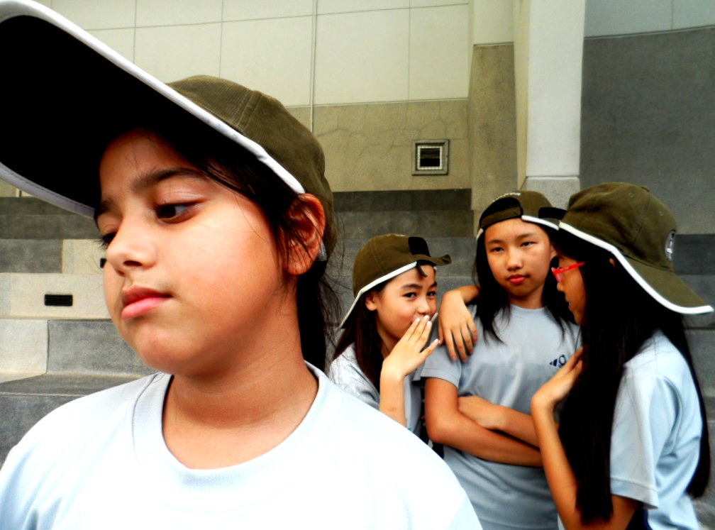
Peer Relationships
Foundational Skills
Challenges
Adolescence
Notes:
This slide describes the importance of peer relationships to social and personality development.
Discussion Question: What are some ways peer relationships can shape a child’s personality?
(Click) Foundational Skills
Interacting with same-age peers provokes the development of many foundational skills used throughout life, such as turn-taking, compromise, and bargaining. Children also begin to find and form friendships with other children they are compatible with. These friends then become sources of support and security.
(Click) Challenges
Relationships between peers also pose complex challenges. Peer rejection can provoke behavior problems. Bullying and conformity pressures, as well as social comparison, are also challenging; successfully navigating early relationships lays the foundation for managing the stressors in adult relationships.
(Click) Adolescence
As children approach adolescence, peer relationships become focused on psychological intimacy, involving personal disclosure, vulnerability, and loyalty (or betrayal).

Slide 9
Overview
Introduction
Family Relationships
Early Attachments
Parenting styles
Peer Relationships
Social Understanding
Personality
Social and Emotional Competence
Activity
Notes:
The purpose of this slide is to provide an overview of the material that will be covered in the lecture.

Slide 10
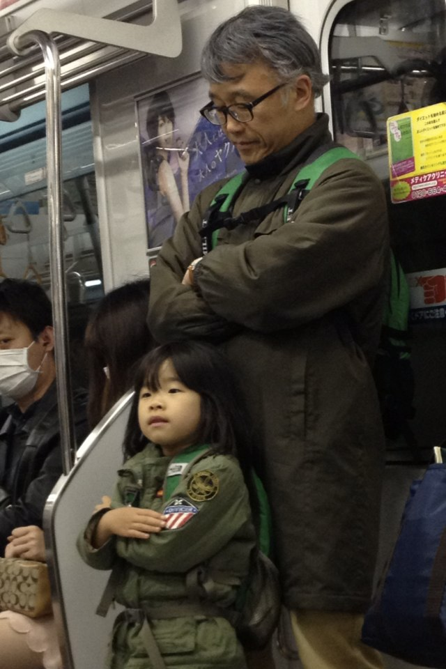
Social Understanding
Relationships Are Essential
Early Forms of Social Understanding
Social Referencing
Theory of Mind
Observation & Explanation
Notes:
This slide emphasizes the importance of social understanding and how it develops.
(Click) Relationships Are Essential
Discussion Topic: We all know relationships are important for human development in terms of bonding and nurturing. What are some ways relationships promote a formative, learning environment?
Explanation: Relationships are essential for children to develop certain social expectations and an understanding of how to interact with others. Relationships also provide a significant amount of emotional development.
(Click) Early Forms of Social Understanding
Early forms of social understanding are seen in infants, such as:
(Click) Social Referencing
In infancy, children use social referencing, which entails looking at their mother for cues regarding appropriate social behavior in unfamiliar situations with unfamiliar people. Click the “Social Referencing” link to play a video showing how important social referencing is for infants by the reactions when they do not get the social interaction.
(Click) Theory of Mind
Infants were originally thought to be egocentric and unaware of others’ internal mental states. However, infants are aware of others—their emotions, and their motivations—from a very early age. Being aware of others’ mental states is called Theory of Mind. Click the “Theory of Mind” link to play a video illustrating the differences between a 3 and 4 year old in their application of Theory of Mind.
Note: Theory of Mind (e.g., understanding goals and motivations) is observable as early as 18 months of age.
(Click) Observation & Explanation
Finally, reinforce for students that children continue to master social skills with increasing sophistication throughout development by watching adults and by adults interpreting social situations for them.

Slide 11
Overview
Introduction
Family Relationships
Early Attachments
Parenting styles
Peer Relationships
Social Understanding
Personality
Social and Emotional Competence
Activity
Notes:
The purpose of this slide is to provide an overview of the material that will be covered in the lecture.

Slide 12

Personality
Temperament is not the be-all end-all
Importance of Fit
Biological Disposition
+ Experience
= Personality
Elaboration, Extension & Refinement
Notes:
This slide describes the development of personality throughout the life.
Explanation: Temperament has a strong biological foundation and is described as the early emergence of differences in reactivity and self-regulation. Though temperament is not the be-all end-all in the determination of personality, a baby’s temperament does play an important role in the types of experiences they are likely to have.
Discussion Question: How might a baby’s temperament affect the care he or she receives?
Example: A fussy baby may illicit more severe parenting practices than an easygoing baby.
(Click) Importance of Fit
Discussion Question: What do we mean by “fit”?
(Click) Biological Disposition + Experience = Personality
Explanation: Consider the intersection where temperament meets environment. For example if a highly reactive child is born into a family that prefers a sedentary lifestyle, distress is a likely outcome, impacting familial conflict, the child’s self-esteem, and personality.
(Click) Elaboration, Extension & Refinement
Summary: As personality continues to develop, other influences and characteristics begin to emerge in the form of a self-concept, motivations to achieve and/or socialize, values and goals, coping styles, responsibility, and conscientiousness. Later in development these personality traits shape the dynamics of close relationships.

Slide 13
Overview
Introduction
Family Relationships
Early Attachments
Parenting styles
Peer Relationships
Social Understanding
Personality
Social and Emotional Competence
Activity
Notes:
The purpose of this slide is to provide an overview of the material that will be covered in the lecture.

Slide 14
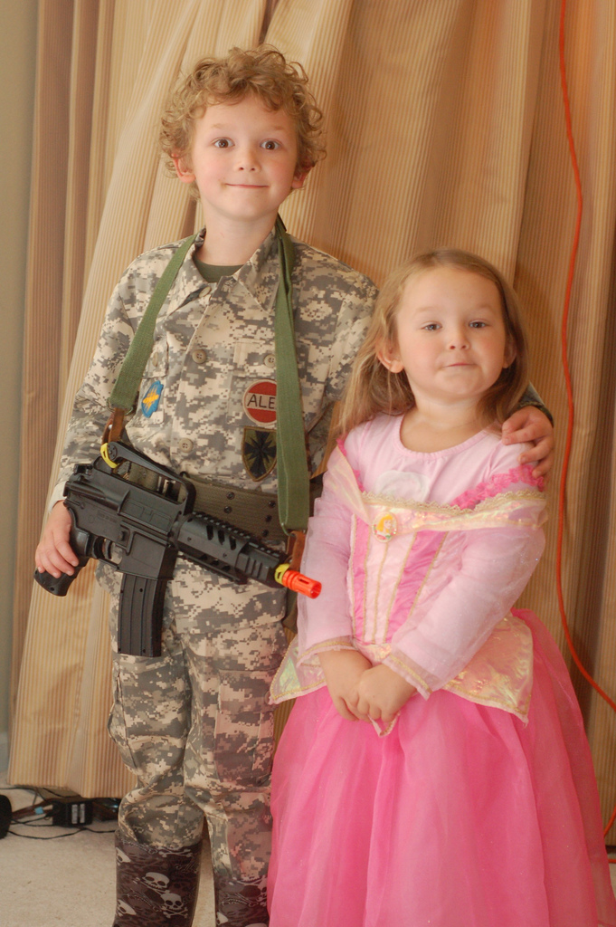
Social & Emotional Competence
Characteristics
Conscience
Effortful Control
Gender Schema
Social & Biological Influences on Gender Schema?
Notes:
This slide illustrates characteristics of social and emotional competence that arise out of the previously discussed social, biological, and representational influences.
Discussion Topic: To what degree is a child’s social and emotional competence inherent vs. experiential?
(Click)
Conscience
Explanation: Conscience is considered the outcome of cognitive, emotional, and social influences that cause young children to regulate their behavior according internal standards of conduct. Conscience emerges primarily from mutually responsive relationships that motivate young children to respond constructively to requests and expectations, and is reinforced by a good fit between a child’s temperament and parents’ ability to communicate behavioral expectations.
Effortful Control
Explanation: Whereas some children are born with an inherent ability to regulate themselves, others develop this throughout their life and only through practice.
Gender Schema
Explanation: Gender Schema, or a child’s “maleness” or “femaleness”, develops as a result of the interaction between social, biological, and representational influences.
(Click) Social & Biological Influences on Gender Schema?
Discussion Question: What are some social and biological factors that may influence the development of Gender Schema?
Student-generated biological influences might include: hormones, genes, puberty, etc.
Student-generated social influences might include: social cliques, toys (e.g., dolls, toy cars), clothing (e.g., dresses, shoes, clothing colors), the way others respond (e.g., adults being more likely to comfort a girl who falls than a boy), etc.

Slide 15
Overview
Introduction
Family Relationships
Early Attachments
Parenting styles
Peer Relationships
Social Understanding
Personality
Social and Emotional Competence
Activity
Notes:
The purpose of this slide is to provide an overview of the material that will be covered in the lecture.

Slide 16

Activity: Moral Development
Notes:
This slide provides an activity that illustrates the concept of moral development using Kohlberg’s Dilemma.
Activity (This activity can be administered as a formal debate or a group discussion.):
Propose the following scenario to students (For further information see IM > Unit Development > Module 2: Social and Personality Development in Childhood > Activities/Demonstrations):
Kohlberg’s “Heinz Dilemma”:
A woman was near death from a special kind of cancer. There was one drug that the doctors thought might save her. It was a form of radium that a druggist in the same town had recently discovered. The drug was expensive to make, but the druggist was charging 10 times what the drug cost him to make. He paid $200 for the radium and charged $2000 for a small dose of the drug. The sick woman’s husband, Heinz, went to everyone he knew to borrow the money, but he could get together only about $1000, which was half of what it cost. He told the druggist that his wife was dying and asked him to sell it cheaper or let him pay later. But the druggist said, “No, I discovered the drug and I’m going to make money from it.” Heinz got desperate and broke into the man’s store to steal the drug for his wife.
Discussion Questions: Was Heinz right or wrong? What would you do?
Click to the next slide to display a chart of Kohlberg’s stages of moral development.

Slide 17
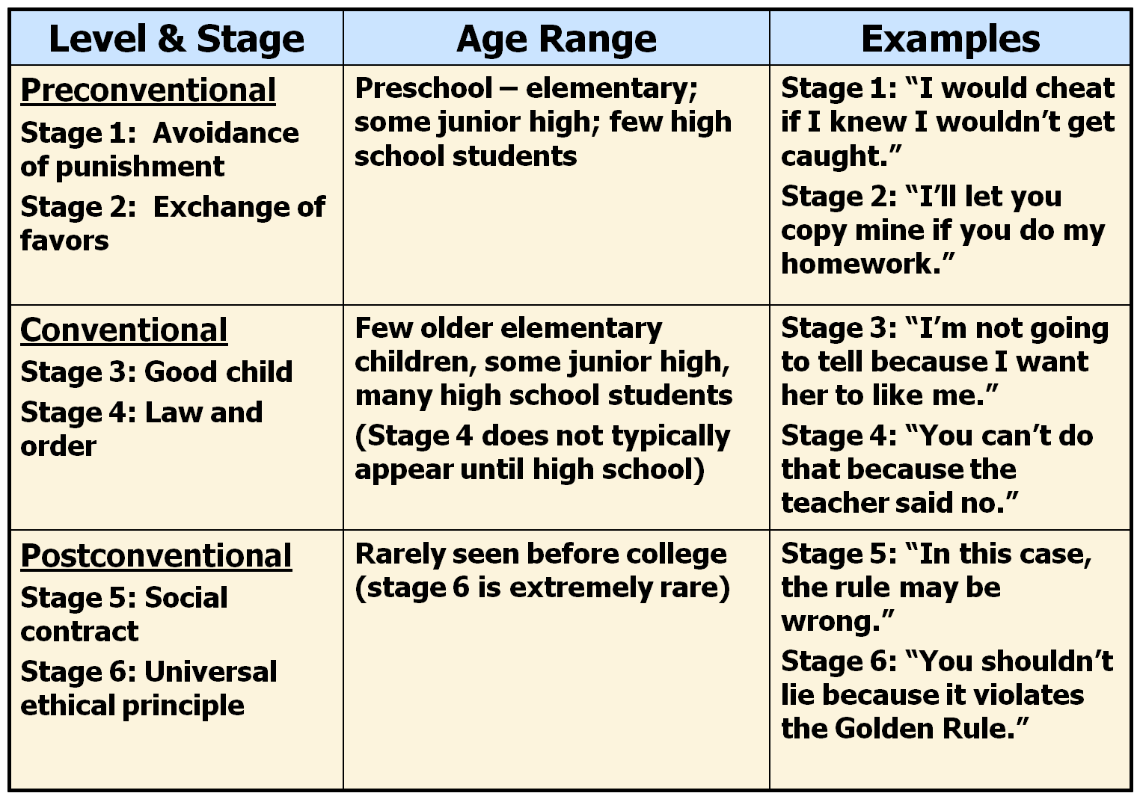
Stages of Moral Development
Notes:
This is a chart illustrating Kohlberg’s stages of moral development.
Instructor’s note: Discuss the distinctions between the various stages, and how they might apply to the Heinz scenario from the previous slide.

Slide 18
Photo Attribution
Slide 1 | Photo Credit: Oude School https://www.flickr.com/photos/61656851@N00/414726015/ https://creativecommons.org/licenses/by-nc/2.0/
Slide 3 | Photo Credit: The Hamster Factor https://www.flickr.com/photos/83519847@N00/2371175083/ https://creativecommons.org/licenses/by-nc-nd/2.0/
Slide 5 | Photo Credit: premasagar https://www.flickr.com/photos/54304913@N00/17647469/ https://creativecommons.org/licenses/by-nc/2.0/
Slide 8 | Photo Credit: Cecko Hanssen https://www.flickr.com/photos/28004991@N00/173744986/ https://creativecommons.org/licenses/by-nc-sa/2.0/
Slide 8 | Photo Credit: nist6ss https://www.flickr.com/photos/53771866@N05/7040908861/ https://creativecommons.org/licenses/by-sa/2.0/
Slide 10 | Photo Credit: Aneliza78 https://www.flickr.com/photos/9839335@N04/10450540046/ https://creativecommons.org/licenses/by-nc/2.0/
Slide 12 | Photo Credit: Thomas Hawk https://www.flickr.com/photos/51035555243@N01/8632488309/ https://creativecommons.org/licenses/by-nc/2.0/
Slide 14 | Photo Credit: Mandajuice https://www.flickr.com/photos/60449310@N00/5139069106/ https://creativecommons.org/licenses/by-nc-sa/2.0/
Slide 16 | Photo Credit: Bill David Brooks https://www.flickr.com/photos/8011986@N02/2689975613/ https://creativecommons.org/licenses/by-sa/2.0/

